Slide 1
Chronic Diseases Modelling Monthly Design Review May 2024
Ushbah Kaleem

Slide 2
OVERVIEW
Finding possible ways to improve results other than feature engineering and discussion
exploring libraries for their explain ability
lab results inclusion through indirect means
temporal feature engineering, possible strategies
Work on improving inclusion and exclusion criteria of diabetes
Temporal Feature Modelling
Literature Review
Pipeline Implementation
Modelling

Slide 3
RECAP
Finalized Modelling effort on 11 diseases
Best result was that of Heart I25
Model Versions | Heart I25
 | 3 | 6 | 12 Classifier | 12 Survival
 | F1 Score | F1 Score | F1 Score | F1 Score
V3 | 0.796 | 0.780 | 0.768 | 0.783

Slide 4
TEMPORAL FEATURE ENGINEERING
1. Time Windowing
2. Lag Features
3. Event-Based Features
4. Temporal Aggregation
5. Sequence-Based Methods
6. Temporal Patterns and Trends
7. Temporal Embeddings
8. Change Point Detection
9. Derived Features from Temporal Dynamics
10. Periodic Features
11. Multiscale Features
12. Interpolation and Smoothing
13. Temporal Relationships
14. Composite Features

Slide 5
TEMPORAL FEATURE ENGINEERING
LAG FEATURES
Lag variables are features that represent the value of a variable at previous time points.
captures the temporal dependency and helps predict future outcomes based on past trends.
Example:
Lag 1: Blood pressure value from the previous day.
Lag 3: Average blood pressure value from the past 3 days.
Lag 7: Average blood pressure value from the past week (7 days).

Slide 6
TEMPORAL FEATURE ENGINEERING
Moving Averages
features calculated by taking the average of a variable over a specified number of previous time points.
smooths out short-term fluctuations and highlights longer-term trends.
Example:
For a patient's daily blood glucose readings, a 7-day moving average would represent the average blood glucose level over the past week.
Types of Moving Averages:
Simple Moving Average (SMA): The unweighted mean of the previous n data points.
Exponential Moving Average (EMA): Weighs recent data points more heavily.

Slide 7
TEMPORAL FEATURE ENGINEERING
Moving Averages
features calculated by taking the average of a variable over a specified number of previous time points.
smooths out short-term fluctuations and highlights longer-term trends.
Example:
For a patient's daily blood glucose readings, a 7-day moving average would represent the average blood glucose level over the past week.
Types of Moving Averages:
Simple Moving Average (SMA): The unweighted mean of the previous n data points.
Exponential Moving Average (EMA): Weighs recent data points more heavily.

Slide 8
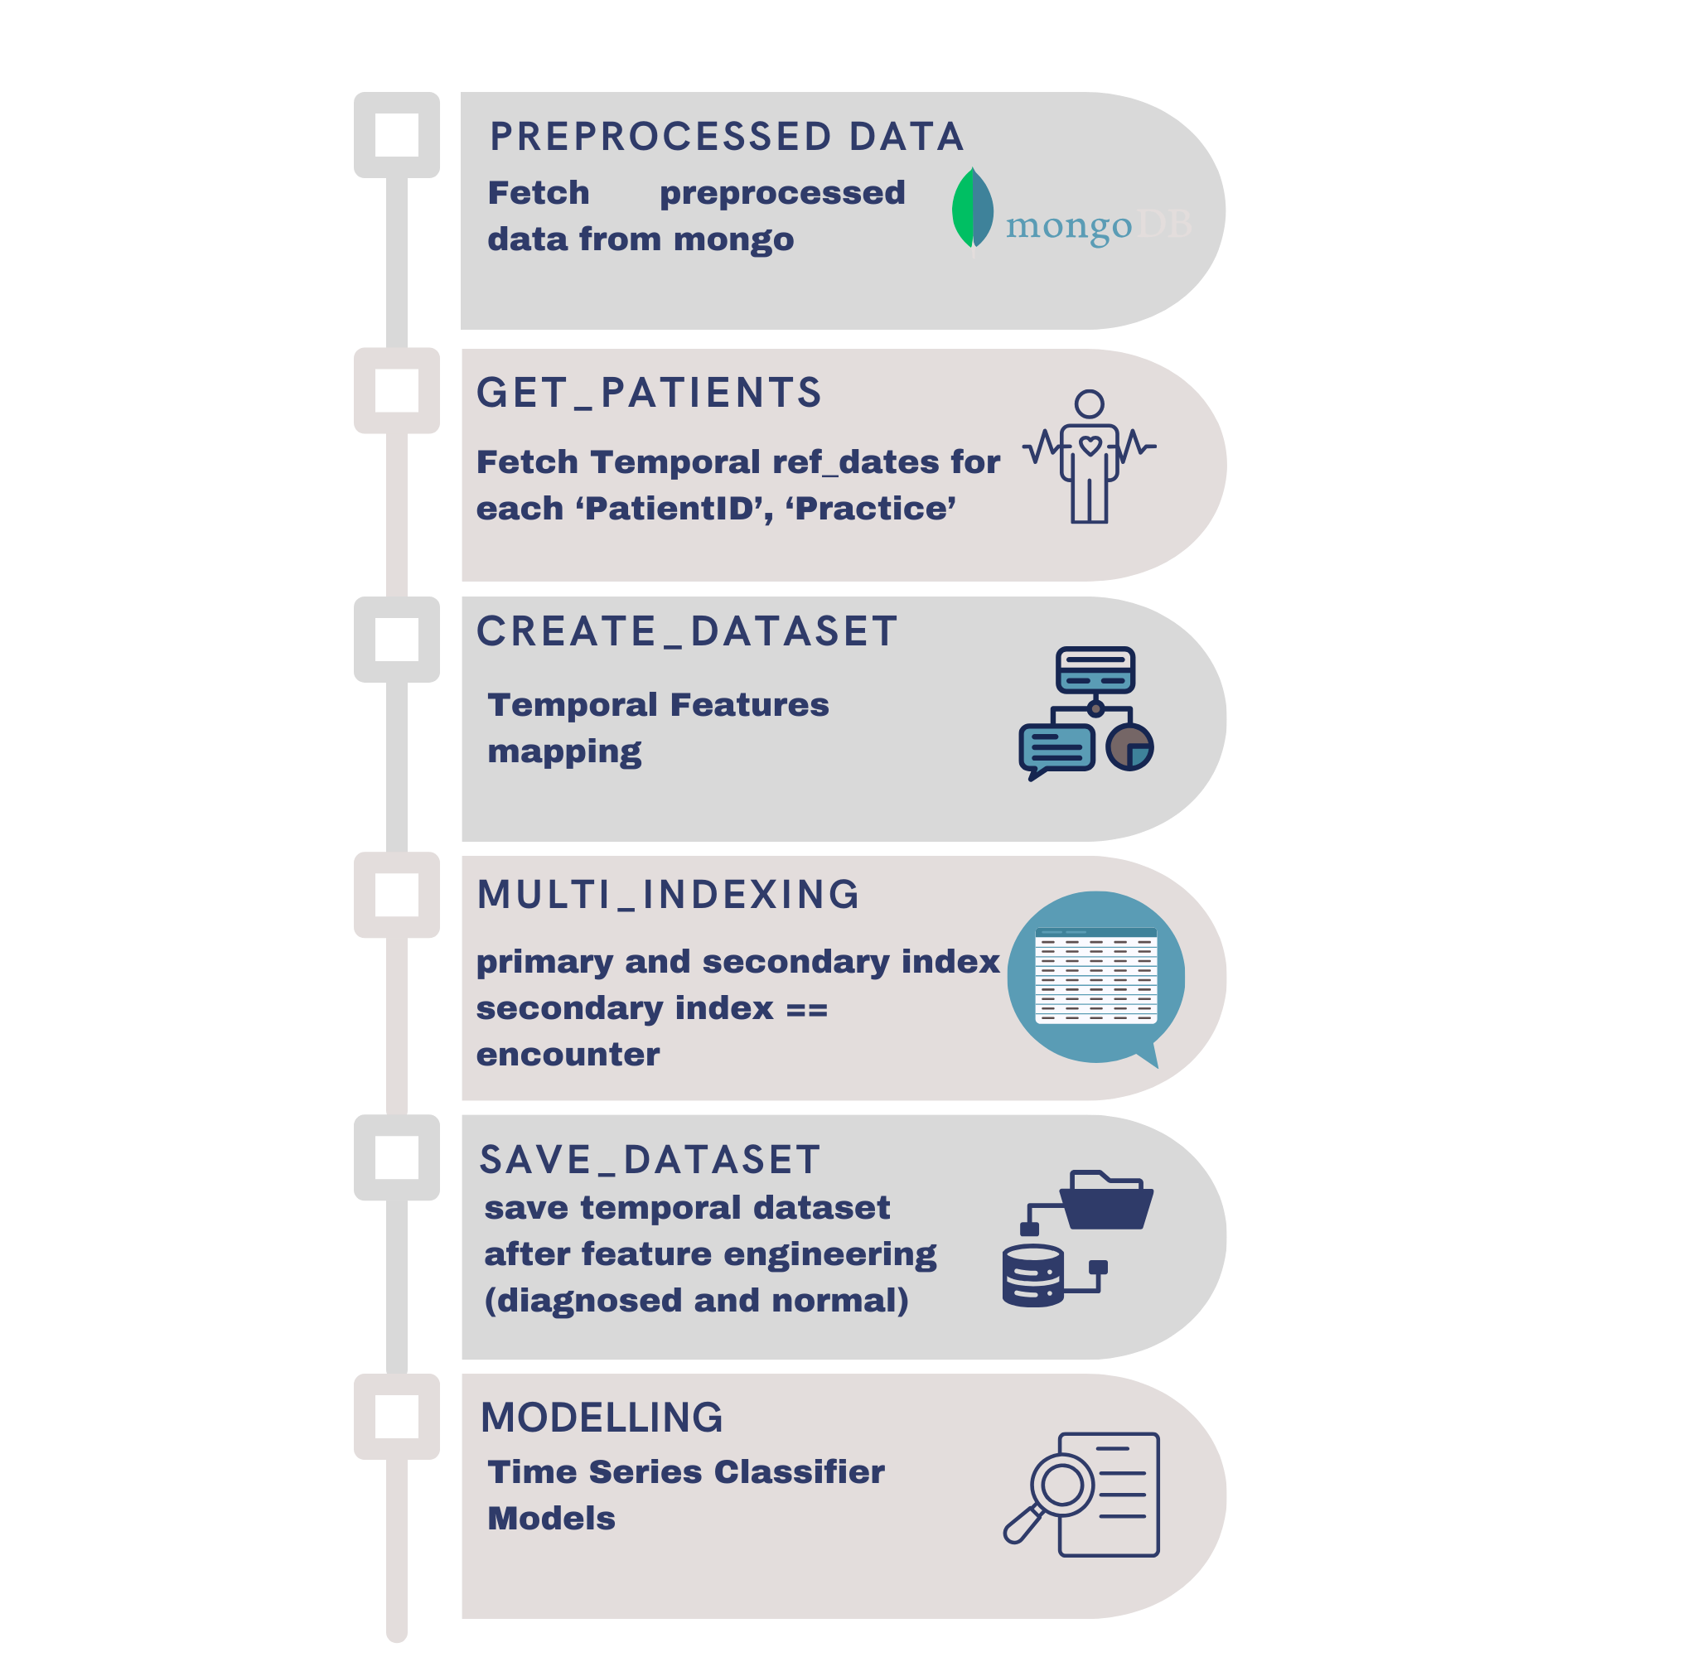
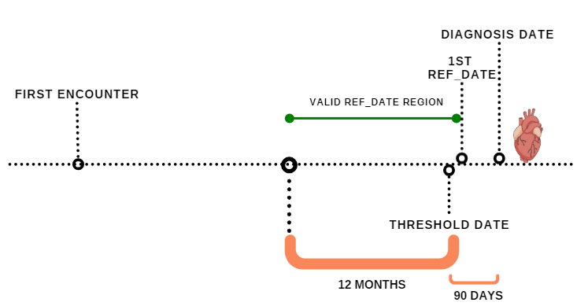
METHODOLOGY

Slide 9
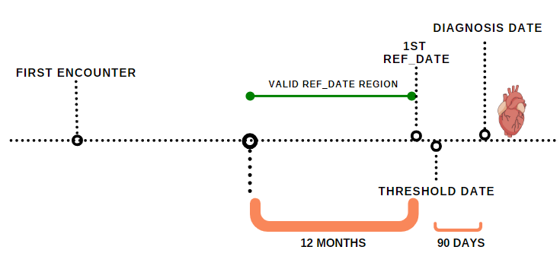
METHODOLOGY

Slide 10
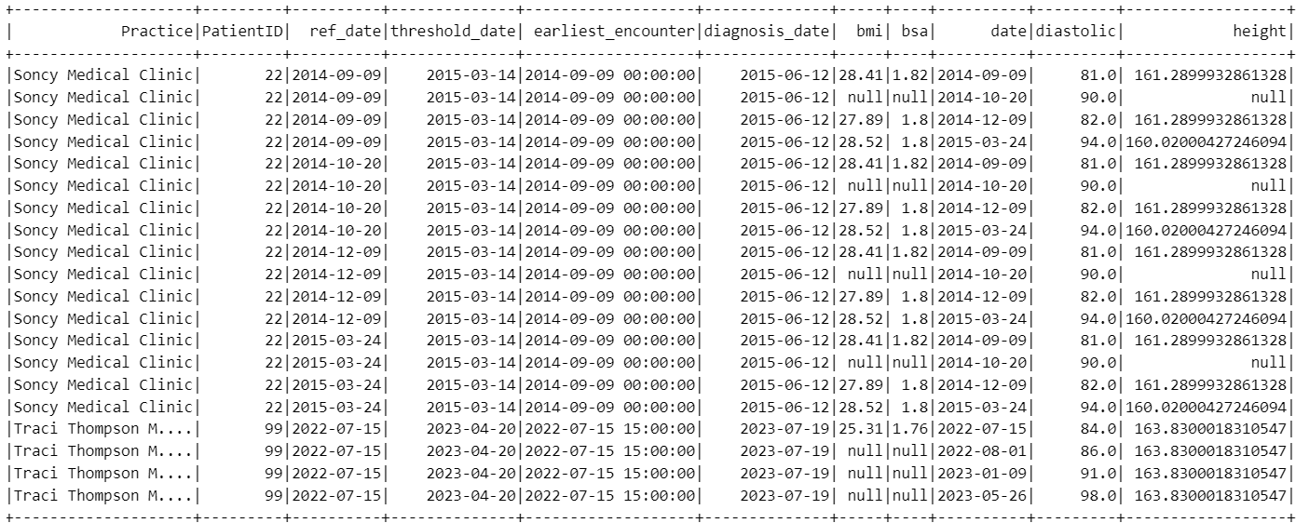
Temporal Feature Engineering
Vitals Table

Slide 11
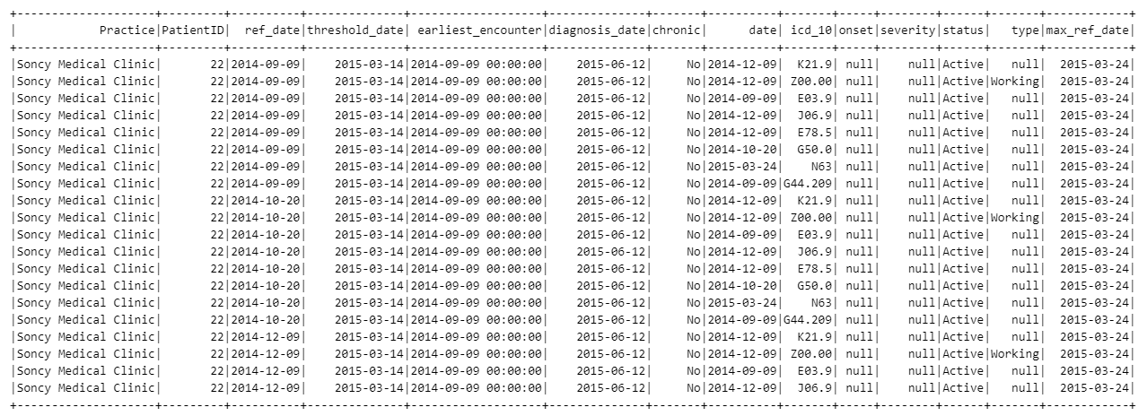
Temporal Feature Engineering
Diagnosis Table

Slide 12
sktime
Python library designed specifically for time series analysis
Extends scikit-learn with tools for handling and modeling time series data.
Handles temporal data efficiently in various domains
Multi-Indexing:
Utilizing multi-indexing to organize temporal data efficiently.
Incorporated patient and practice IDs as multi-index for data organization.
Benefits of multi-indexing:
Efficient manipulation and modeling of hierarchical time series data.
Enhanced data representation and organization.
Facilitates seamless integration with time-based analyses.

Slide 13
sktime models
ROCKET Classifier:
Uses random convolutional kernels to extract features from time series.
Extremely fast, competitive accuracy.
InceptionTime Classifier:
A deep learning model for time series classification.
Handles complex temporal patterns and achieves state-of-the-art performance.
MLP Classifier:
Multi-Layer Perceptron (MLP) is a type of neural network.
Flexible, can model non-linear relationships.
k-Neighbors Time Series Classifier:
A distance-based classifier.
Uses similarity measures to classify time series data.

